Slide 1
1
2016 Annual Report of Virginia Association of Housing and Community Development Officials
1 1
 | this issue
2016 President’s Message P.2 2016 VAHCDO Scholarship Recipients P.3 Social Media Statistics P. 4 VAHCDO Board Members P. 5 Financials P. 6 FSS Financials P. 7 News from the Year P. 8
The Virginia Association of Housing and Community De- velopment Officials (VAHCDO) is dedicated to preserv- ing and maintaining Virginia’s existing housing re- sources; improving the health and living standards of the people of Virginia; and developing new housing op- portunities throughout the Commonwealth. VAHCDO represents agencies and localities that use federal, state and local funds for the development, construction and maintenance of housing.
VAHCDO plays an important role in the formulation of housing and redevelopment policy in the Common- wealth of Virginia. Such policy influence results from the strength and support of our member agencies and the effective leadership of Board of Directors. VAHCDO rep- resentatives interact regularly with the Virginia Housing Development Authority (VHDA), Virginia Department of Housing and Community Development (VDHCD), Virgin- ia Housing Study Commission, and the Virginia Office of the U.S. Department of Housing and Urban Develop- ment (HUD).
• | Leadership diligently serves the mem-
 | bership’s interests and needs through
 | their liaison with Congress, HUD, and
 | other federal agencies.
• | Members have the opportunity to
 | articulate how national policies will
 | impact on local programs.
• | Opportunities to participate in confer-
 | ences and training programs puts you
 | in touch with your colleagues
 | throughout the state.
• | Provides members with insights into
 | HUD and Congressional actions, job
 | vacancies, and major developments
 | in the public housing field.

Slide 2
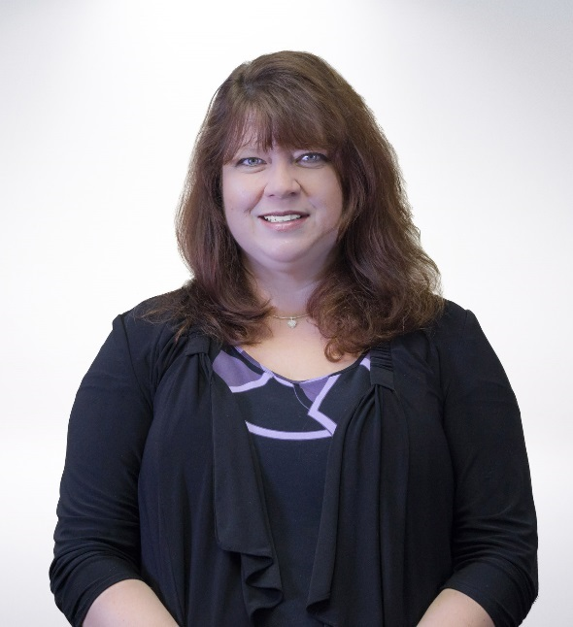
2
2 2
A Message From Our Past President
On behalf of the Virginia Association of Housing and Community Development Officials (VAHCDO), I would like to extend a warm welcome to you.
As part of the growing housing community in Virginia, we know that you will find VAHCDO is the organization that most significantly impacts the way Virginia is viewed in the affordable redevelopment and housing communities.
We believe that you will find that the programs and activities of VAHCDO are innovative and reflect the shared interests and needs of its members. Along with the programs and activities, you will discover an organization committed to advocating for your agency’s interests. We hope you will contact us to suggest programs, events, or informative services that you, as a VAHCDO member, would like to see provided.
There is a multitude of opportunities to become involved in our organization throughout the year, and we hope you will encourage your staff to take an active interest in the Virginia Association of Housing and Community Development Officials.
For your information, we have enclosed our most recent Annual Report. You will be receiving notifications to the e-mail address designated on your application. Lastly, please visit our website www.VAHCDO.org and Facebook page regularly to stay on top of upcoming training, industry news, job openings, and events.
Lisa Porter
Virginia Association of Housing and Community Development

Slide 3
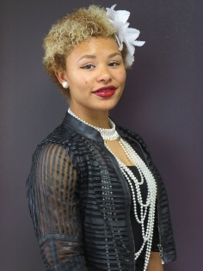
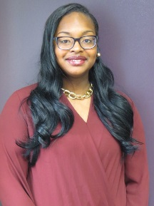
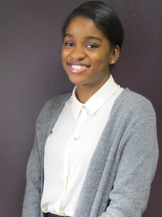
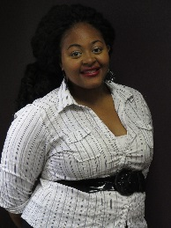
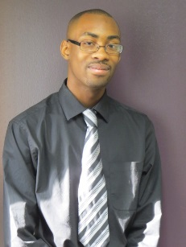
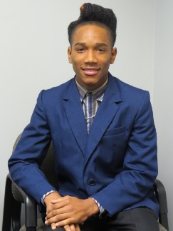
3
3 3
Shion S. Brooks
Hopewell Redevelopment and Housing Authority
Shion has a 3.0 GPA. She is involved in various extracurricular activities to
include a school based mentoring and motivational girls group and a community based
Women Ministry.
2016 Scholarship Recipients
Shyona Wheeler
Hopewell Redevelopment and Housing Authority
Shyona has a 3.8 GPA. She is involved in various extracurricular activities to include Junior ROTC at her school and volunteering at a local Nursing Home.
Mai-Asia Brown
Richmond Redevelopment and Housing Authority
Mai-Asia has a 4.0 GPA. She is involved in various extracurricular activities to include membership in the Japanese Club and serving as a Laboratory Assistant for her Chemistry Teacher.
Zaria Maldonado
Newport News Redevelopment and Housing Authority
Zaria has a 3.8 GPA. She is involved in various extracurricular activities to include the Heritage High School Concert choir and volunteer at St. Augustine Episcopal Church Outreach Feeding program.
Rashawn Clements
Newport News Redevelopment and Housing Authority
Rashawn has a 3.7 GPA. He is involved in various extracurricular activities to include the Gavel club which focuses on public speaking and the Interact club, a high school version of Rotary International, a service organization.
Tacquan Turner
Norfolk Redevelopment and Housing Authority
Tacquan has a 3.1 GPA. He is involved in various extracurricular activities to include Young Gardeners.
2016 VAHCDO
Scholarship Committee
Steven Benham, Chairperson , Hopewell RHA Gwendolyn Blue , Franklin RHA Cynthia Pankey , Hampton RHA Deborah Morton Danville RHA Carol Thomas, Portsmouth RHA
“Education is the most powerful weapon which you can use to change the world.” - Nelson Mandela

Slide 4
4
5 5
Social Media Statistics
Face Book Statistics
Face Book Fans:
196 Total likes
188 Following

Slide 5
5
VAHCDO Board Members
6 6
Lance Allen - Staunton RHA
Steve Benham - Hopewell RHA
Donnell Brown - Norfolk RHA
Carol Jones-Gilbert - Richmond RHA
Aaru Maat – Hampton RHA
Clarissa McAdoo - Suffolk RHA
Philip Page - Franklin RHA
Madelyn Peay - Hopewell RHA
Lisa Porter - Marion RHA
Sandra Powell - Newport News RHA
Keith Sherrill – VHDA
Ed Ware - Norfolk RHA
Michael Wong – Harrisonburg

Slide 6
Itemized Categories 10/1/2015 through 9/30/2016 (Cash Basis) 1/31/2017 Financials: INCOME 163,256.75 Conference Income 28,545.00 Dues Income 19,407.00 Interest Inc 10.45 Misc. Income 6.00 Scholarship Income 27,613.00 Trainings Income 87,675.30 EXPENSES -168,845.88 Conference Exp -38,681.05 Contributions Exp -16,850.00 Operations -23,602.22 Scholarship Exp -9,000.00 Trainings Expenses -80,712.61 OVERALL TOTAL -5,589.13
6
7 7

Slide 7
7
3 3
Family Self-Sufficiency families have purchased homes in various cities in Hampton Roads. Total purchase prices by locality:
Newport News | $16,196,031 | 142 – Homebuyers
Hampton | $2,213,467 | 21 – Homebuyers
Williamsburg | $115,000 | 1 – Homebuyer
Gloucester | $103,889 | 1 – Homebuyer
Yorktown | $80,000 | 1 – Homebuyer
James City County | $81,500 | 1 – Homebuyer
TOTAL: | $18,789,887
.

Slide 8
8
News from the Year
NNRHA ASSISTING FAMILIES PURCHASE HOMES IN NEWPORT NEWS
The Newport News Redevelopment and Housing Authority has assisted 167 families through the Family Self-Sufficiency (FSS) Homeownership Program; of those, 142 bought homes in Newport News. The remainder purchased homes in other Peninsula localities. This generated almost $18.8 million in sales with $16.1 million being in Newport News.
What Home Means To Me
Vahcdo In Partnership With Nahro Is Sponsoring “What Home Means To Me” Poster Contest.Eligibility and Selection Categories: Contest participation is open to all children residing in affordable housing assisted directly or supported under community development and affordable housing programs administered by a NAHRO member authority (i.e., public or Section 8-assisted housing CDBG, HOME, LIHTC).
LISC Names New CEO
Maurice Jones will replace Michael Rubinger as head of the organization in September.By Donna KimuraMaurice Jones, who rose from a small-town tobacco farm to become a leader in government and business, was named president and CEO of the Local Initiatives Support Corp. (LISC).Jones, Virginia’s secretary of commerce and trade since 2014, was unanimously selected by the LISC board to replace Michael Rubinger, who announced last year that he was stepping down after 17 years.
NRHA ANNOUNCES KEY EXECUTIVE APPOINTMENTS
Norfolk, VA (February 19, 2016) – Norfolk Redevelopment and Housing Authority (NRHA) has announced the following appointments:Phyllis S. Armistead has been promoted to Chief Housing Officer, where she will be responsible for a portfolio of about 3,500 assisted-rental units at 15 properties and 2,800 Housing Choice Vouchers (HCV). Armistead has worked for NRHA for over 25 years and served in such capacities as Midrise Manager, Elderly Program Manager, Director of Property Management.

